Slide 1

Credit Card Default Risk Analysis
SQL +TABLEAU || PERSONAL PROJECT

Slide 2

PROBLEM STATEMENT & DATA SET
Problem Statement
Credit card companies face financial risk when clients default on payments. The goal of this project is to analyze customer demographics and payment histories to identify which groups are most at risk of defaulting. Insights from this analysis can inform more effective risk management and lending strategies.
Dataset
Records: 30,000 customers
Key fields: Demographics: Age, Gender, Education, Marital Status

Slide 3

Objective
Understand drivers of default
1
Segment Clients by age, gender, marital status, and education status
2
Recommend risk management strategies
3

Slide 4
Data & Methodology
SQL Queries were utilized to clean and analyze the dataset
Aggregated default rates by demographics and credit limits
Past payment history analyzed vs likelihood of future defaults
Tableau dashboards for visualization

Slide 5

Key Insights
The 40+ age group had the highest default rate, while defaults among 30–39-year-olds were the most severe
Male clients defaulted more often (24.17%) than female clients (20.78%)
With all demographics considered, the group with the highest default rates of 60% is graduate school females in the 18-29 age group who have no relationship status
Clients with poor repayment history were significantly more likely to default in the following month.
Clients with credit limits under $50k defaulted the most (36.07%). While higher credit limits generally reduced default risk, even clients with >$500k limits had an 11.21% default rate

Slide 6
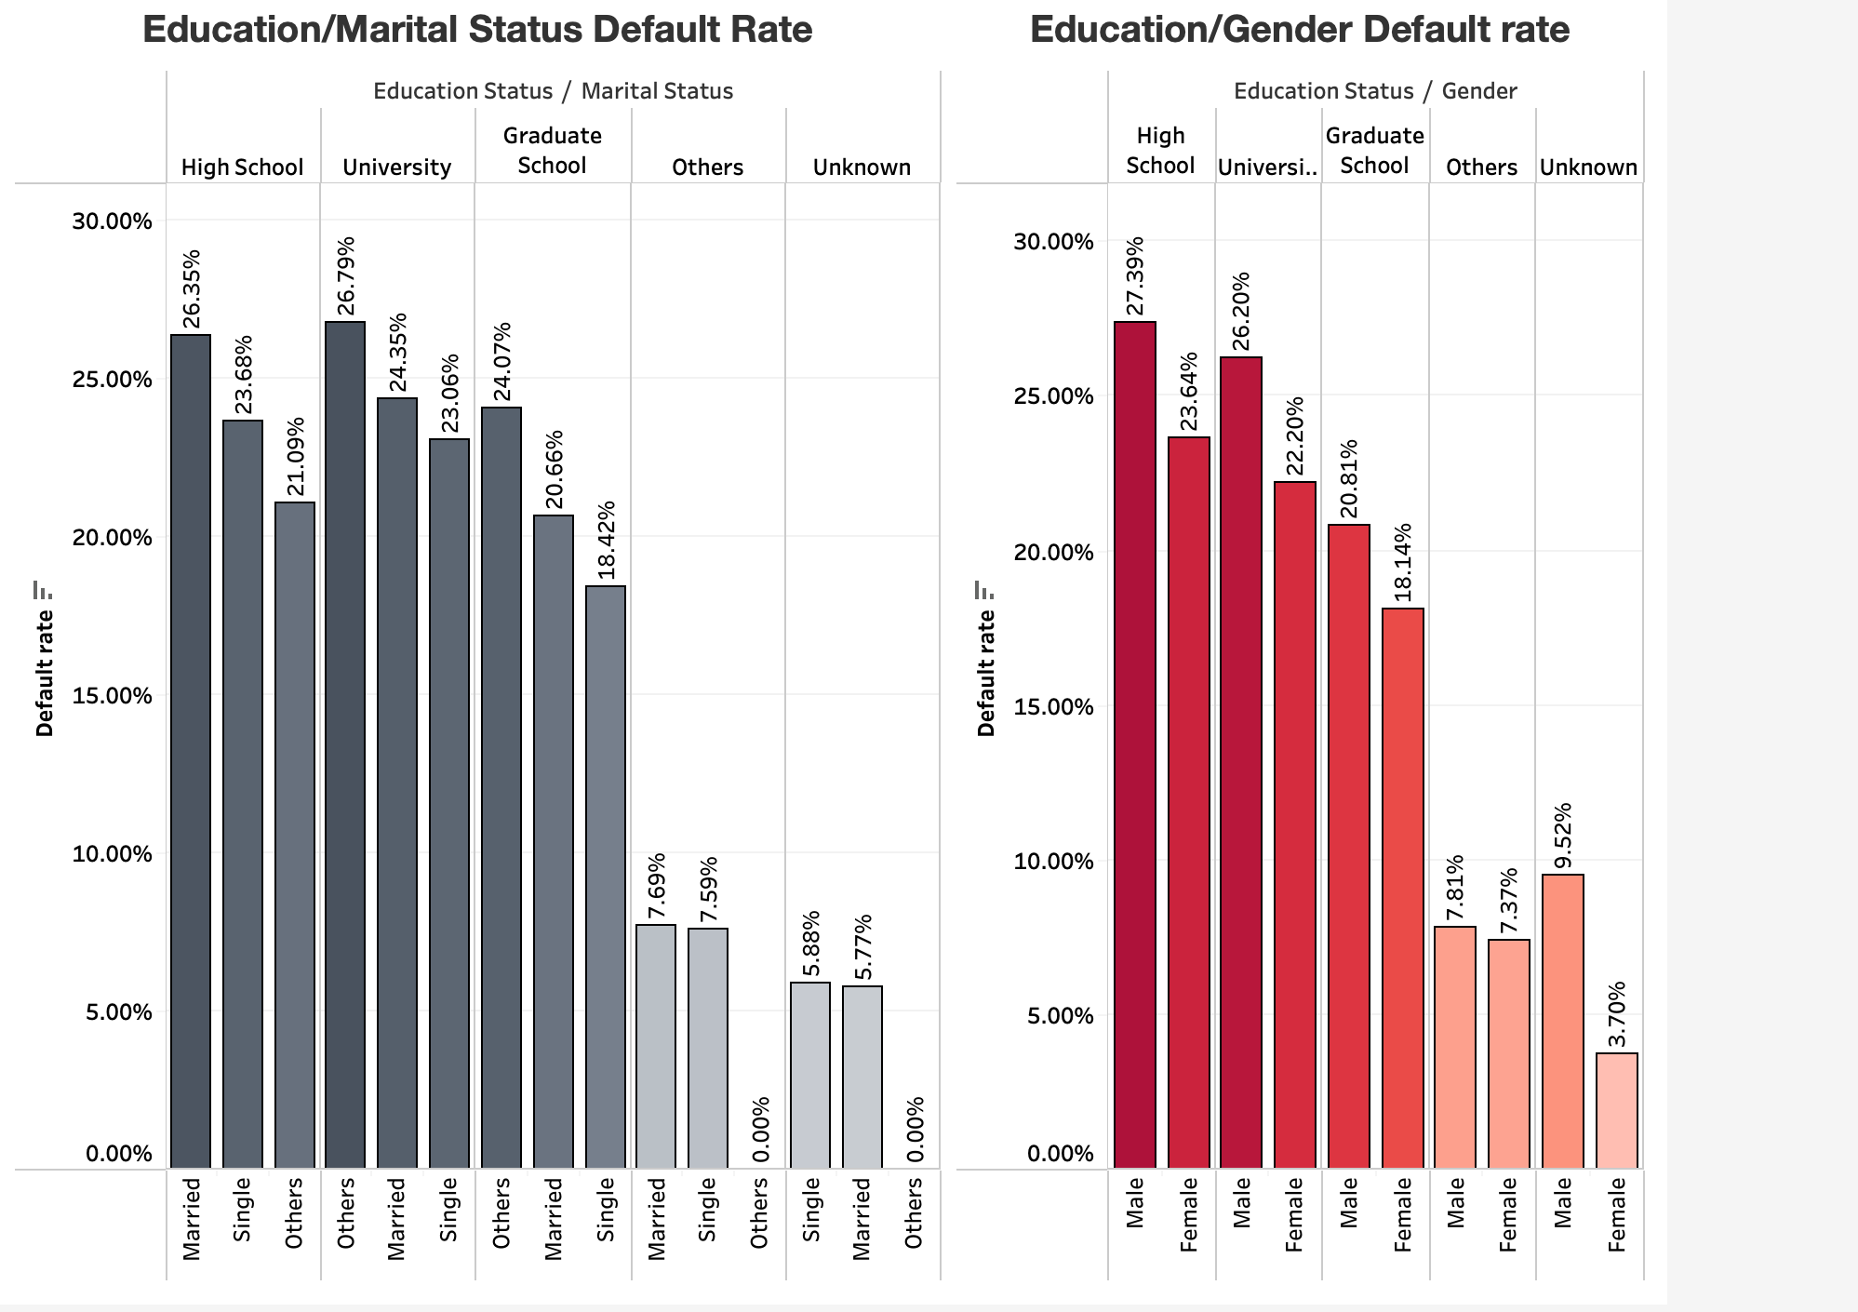
TABLEAU DASHBOARD

Slide 7
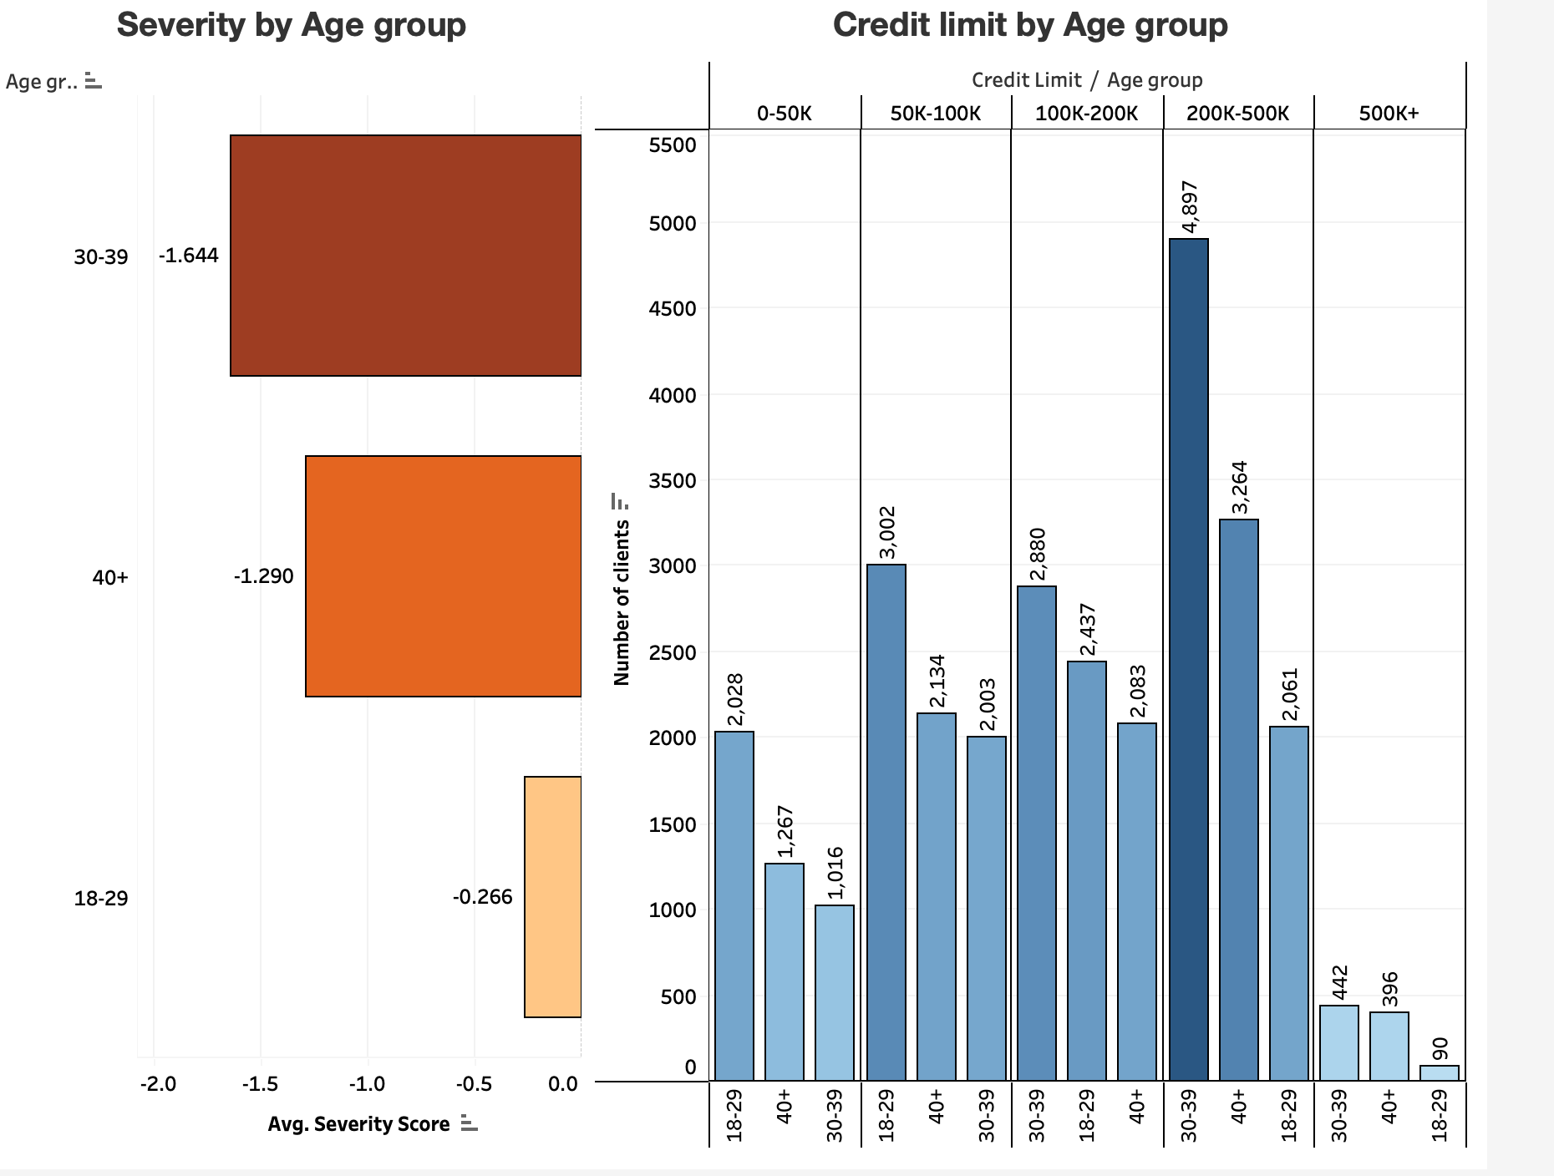
TABLEAU DASHBOARD

Slide 8
Recommendations
Focus risk monitoring on 30–39 age group
Strengthen early intervention for clients with repeated late payments
Use payment history to flag high-risk accounts proactively

Slide 9
Links
📊 Tableau Dashboard
💻 SQL Code on GitHub
Dataset from Kaggle

